Slide 1
COT5615: Math for Intelligent Systems I
Anand Rangarajan
Lecture 35

Slide 2
The Linear Assignment Problem
An exercise in self-indulgence
Known by many names: Stable marriage problem
A set of potential brides give preferences to a set of potential grooms
Maximize the overall preference measure by pairing brides and grooms: 1-1
Still used today to assign medical residents to universities
Problem is in P
Many polynomial-time algorithms
Shortest augmenting paths (Jonker and Volgenant, 1987): Current favorite
Fun problem from a nonlinear optimization perspective

Slide 3
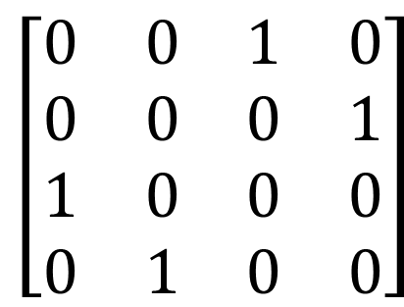
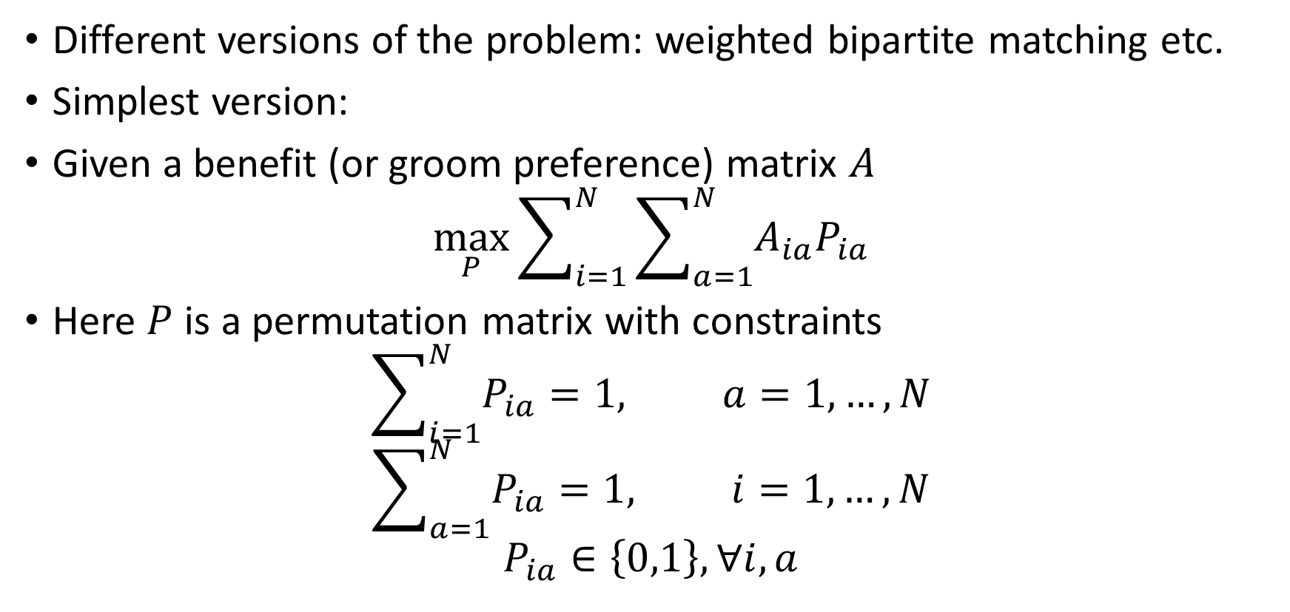
Formulating the problem
Different versions of the problem: weighted bipartite matching etc.
Simplest version:
Given a benefit (or groom preference) matrix $A$
$$\max_{P}{\sum_{i=1}^{N}{\sum_{a=1}^{N}{A_{ia}P_{ia}}}}$$
Here $P$ is a permutation matrix with constraints
$$\sum_{i=1}^{N}{P_{ia}}=1, a=1,…,N$$
$$\sum_{a=1}^{N}{P_{ia}}=1, i=1,…,N$$
$$P_{ia}∈\left\{0,1\right\},∀i,a$$
$$\left[\begin{matrix}0 & 0 & 1 & 0 \\ 0 & 0 & 0 & 1 \\ 1 & 0 & 0 & 0 \\ 0 & 1 & 0 & 0\end{matrix}\right]$$

Slide 4
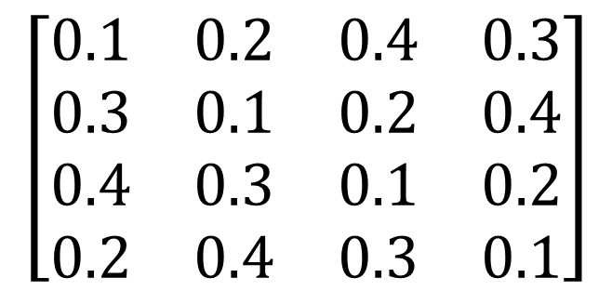
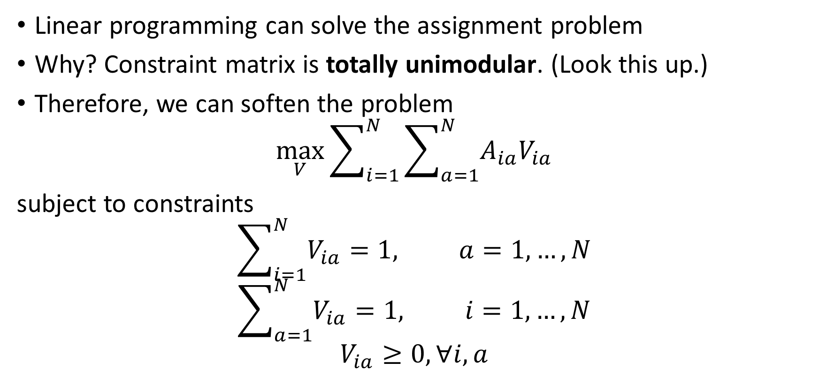
Softening the problem
Linear programming can solve the assignment problem
Why? Constraint matrix is totally unimodular. (Look this up.)
Therefore, we can soften the problem
$$\max_{V}{\sum_{i=1}^{N}{\sum_{a=1}^{N}{A_{ia}V_{ia}}}}$$
subject to constraints
$$\sum_{i=1}^{N}{V_{ia}}=1, a=1,…,N$$
$$\sum_{a=1}^{N}{V_{ia}}=1, i=1,…,N$$
$$V_{ia}≥0,∀i,a$$
$$\left[\begin{matrix}0.1 & 0.2 & 0.4 & 0.3 \\ 0.3 & 0.1 & 0.2 & 0.4 \\ 0.4 & 0.3 & 0.1 & 0.2 \\ 0.2 & 0.4 & 0.3 & 0.1\end{matrix}\right]$$

Slide 5
Constrained Optimization
What’s the relevance to us?
Learning to rank etc. are permutation problems
Constrained optimization here is tailor-made for Lagrange parameters
Non-negativity constraint? Resonance with maximum entropy?
Sum to one on rows and columns reminiscent of maximum entropy
Doubly stochastic matrix: Non-negative matrix with rows and columns summing to one
Every doubly stochastic matrix is a convex combination of permutation matrices (Birkhoff’s theorem)

Slide 6
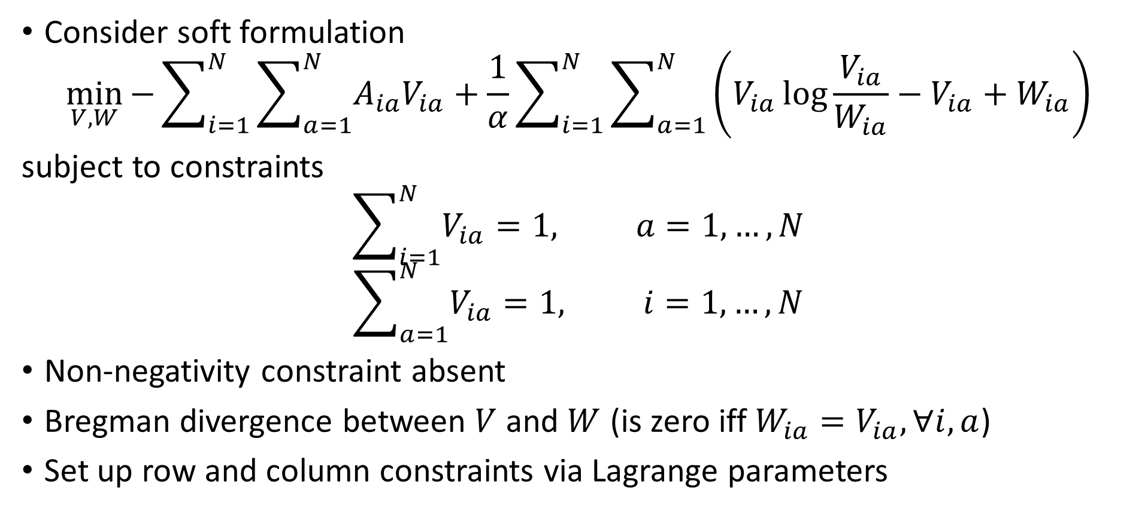
La Villa Strangiato
Consider soft formulation
$$\min_{V,W}{−}\sum_{i=1}^{N}{\sum_{a=1}^{N}{A_{ia}V_{ia}}}+\frac{1}{α}\sum_{i=1}^{N}{\sum_{a=1}^{N}{\left(V_{ia}\log{\frac{V_{ia}}{W_{ia}}}−V_{ia}+W_{ia}\right)}}$$
subject to constraints
$$\sum_{i=1}^{N}{V_{ia}}=1, a=1,…,N$$
$$\sum_{a=1}^{N}{V_{ia}}=1, i=1,…,N$$
Non-negativity constraint absent
Bregman divergence between $V$ and $W$ (is zero iff $W_{ia}=V_{ia},∀i,a$)
Set up row and column constraints via Lagrange parameters

Slide 7
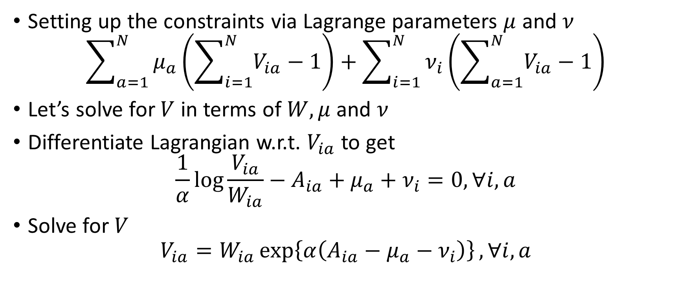
The Constraints
Setting up the constraints via Lagrange parameters $μ$ and $ν$
$$\sum_{a=1}^{N}{μ_{a}\left(\sum_{i=1}^{N}{V_{ia}}−1\right)}+\sum_{i=1}^{N}{ν_{i}\left(\sum_{a=1}^{N}{V_{ia}}−1\right)}$$
Let’s solve for $V$ in terms of $W,μ$ and $ν$
Differentiate Lagrangian w.r.t. $V_{ia}$ to get
$$\frac{1}{α}\log{\frac{V_{ia}}{W_{ia}}}−A_{ia}+μ_{a}+ν_{i}=0, ∀i,a$$
Solve for $V$
$$V_{ia}=W_{ia}\exp\left\{α\left(A_{ia}−μ_{a}−ν_{i}\right)\right\}, ∀i,a$$

Slide 8
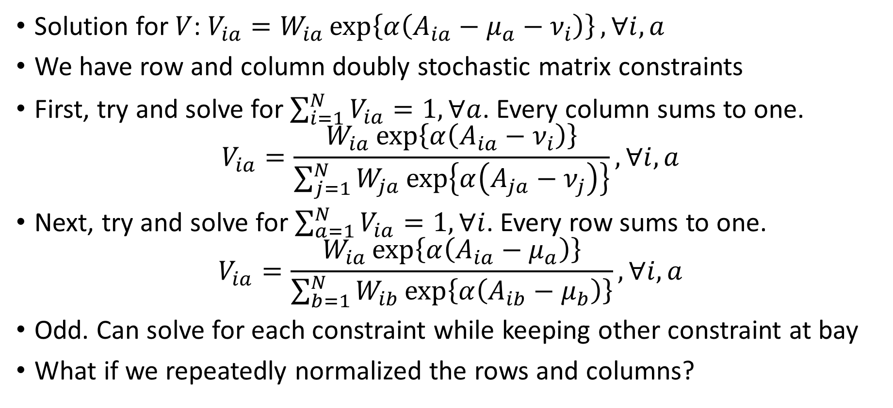
Satisfying the Constraints
Solution for $V$: $V_{ia}=W_{ia}\exp\left\{α\left(A_{ia}−μ_{a}−ν_{i}\right)\right\}, ∀i,a$
We have row and column doubly stochastic matrix constraints
First, try and solve for $\sum_{i=1}^{N}{V_{ia}}=1, ∀a$. Every column sums to one.
$$V_{ia}=\frac{W_{ia}\exp\left\{α\left(A_{ia}−ν_{i}\right)\right\}}{\sum_{j=1}^{N}{W_{ja}\exp\left\{α\left(A_{ja}−ν_{j}\right)\right\}}}, ∀i,a$$
Next, try and solve for $\sum_{a=1}^{N}{V_{ia}}=1, ∀i$. Every row sums to one.
$$V_{ia}=\frac{W_{ia}\exp\left\{α\left(A_{ia}−μ_{a}\right)\right\}}{\sum_{b=1}^{N}{W_{ib}\exp\left\{α\left(A_{ib}−μ_{b}\right)\right\}}}, ∀i,a$$
Odd. Can solve for each constraint while keeping other constraint at bay
What if we repeatedly normalized the rows and columns?

Slide 9
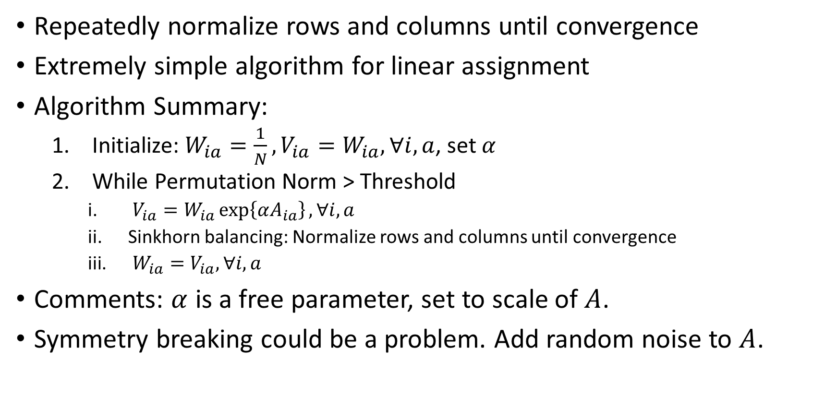
Sinkhorn Balancing
Repeatedly normalize rows and columns until convergence
Extremely simple algorithm for linear assignment
Algorithm Summary:
Initialize: $W_{ia}=\frac{1}{N}, V_{ia}=W_{ia}, ∀i,a$, set $α$
While Permutation Norm > Threshold
$V_{ia}=W_{ia}\exp\left\{αA_{ia}\right\}, ∀i,a$
Sinkhorn balancing: Normalize rows and columns until convergence
$W_{ia}=V_{ia}, ∀i,a$
Comments: $α$ is a free parameter, set to scale of $A$.
Symmetry breaking could be a problem. Add random noise to $A$.

Slide 10
Code Snippets
function V = assbreg(A)
W = ones(N)/N;
V = W;
alpha = 1;
l2thr = 0.001;
permthr = 0.1;
p = permnorm(V);
energy = trace(A'*V);
while p > permthr
V = W.*exp(alpha*A);
sinkhorn = 0;
while rownorm(V) > l2thr,
V = rowcol(V);
sinkhorn += 1;
end
W = V;
energy = trace(A'*V) p = permnorm(V);
end
function V = rowcol(V)
[N,junk] = size(V);
sumc = sum(V);
sumc = diag(sumc);
sumc = ones(N)*sumc;
V = V ./sumc;
sumr = sum(V');
sumr = diag(sumr);
sumr = ones(N)*sumr;
V = V ./sumr';

Slide 11
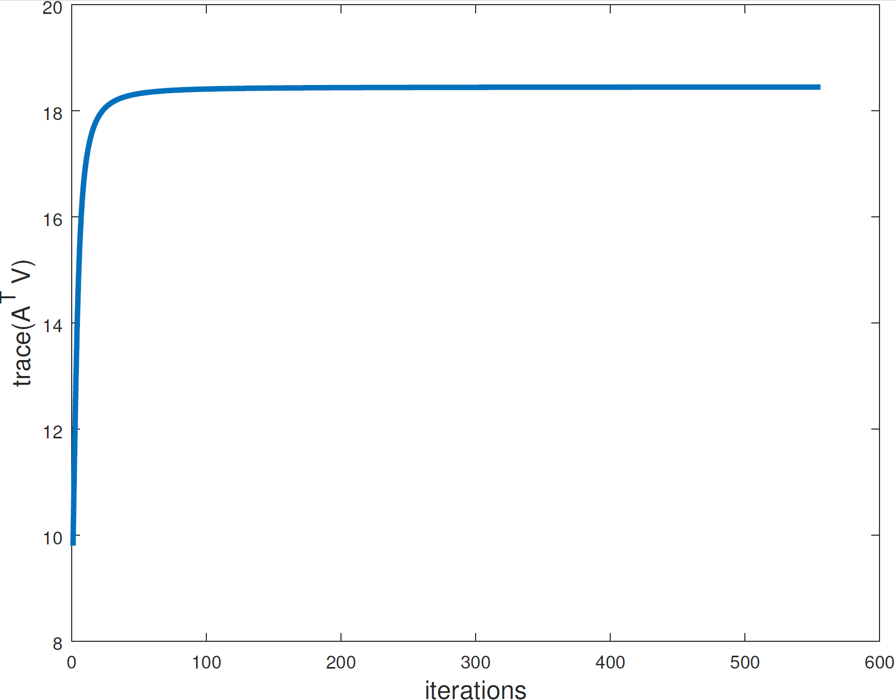
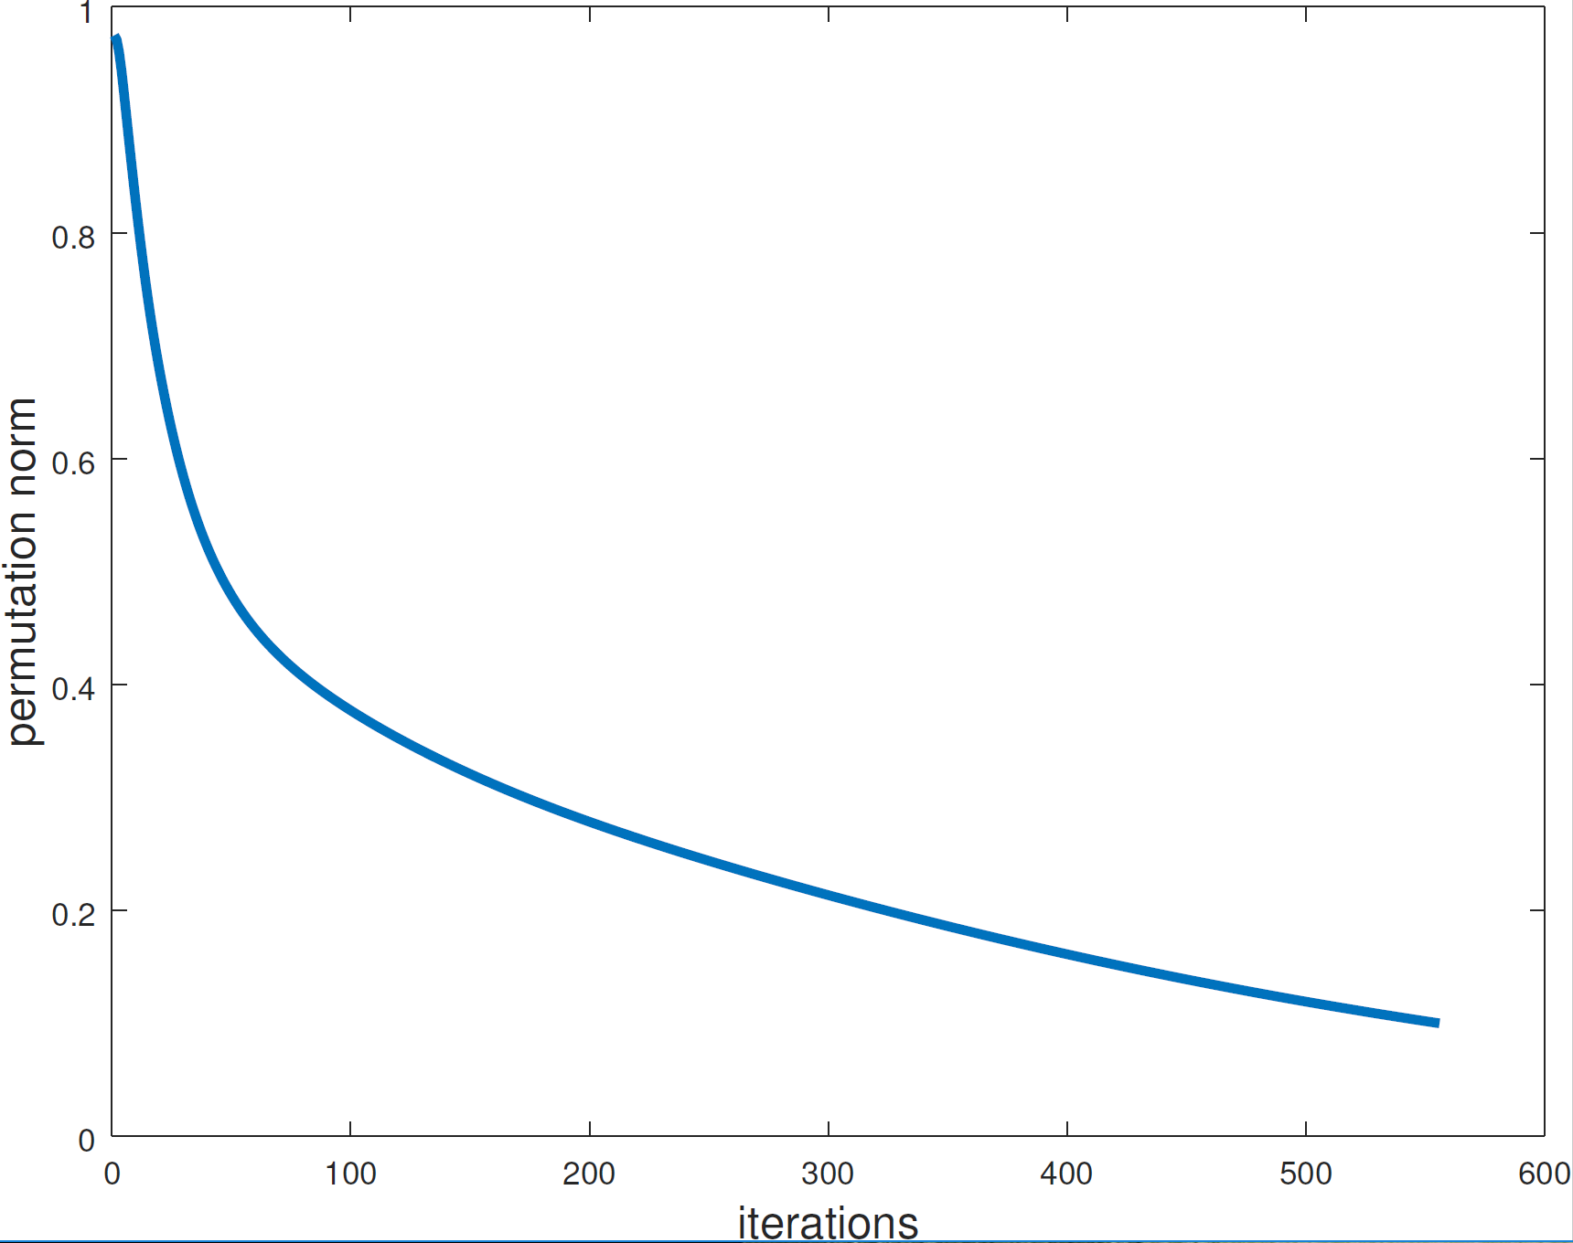
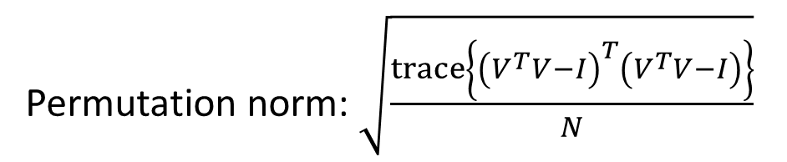
Linear Assignment Plots
Permutation norm: $\sqrt{\frac{trace\left\{{\left(V^{T}V−I\right)}^{T}\left(V^{T}V−I\right)\right\}}{N}}$

Slide 12
Summary
Linear Assignment Problem (a.k.a. weighted bipartite matching etc.)
Linear objective function in permutation matrix
Row and Column (totally unimodular) constraints
Linear Programming can solve this problem
Relax permutation matrix to doubly stochastic matrix
Use Bregman divergence for non-negativity constraint
Solve for doubly stochastic matrix
Sinkhorn balancing
Extremely simple algorithm

